Slide 1
Blockchain Analysis (April 2019)
Daniel Byrne, Benjamin Wilke, Brian Coari, YuMei Bennett
DS7349 – Section 404

Slide 2
Project analysis slide 2
Blockchain Introduction
Developed in 2008 by Satoshi Nakamoto (pseudonym) for use with cryptocurrency called Bitcoin, but can be anywhere that trust, privacy, resilience and security are necessities.
Blockchain is an unchangeable transaction log, digital ledger.
Blockchain is decentralized and public, relying on a community to ensure trust and accountability.

Slide 3
Project analysis slide 2
Origins of Blockchain
Technology based on “Blind Signatures” by David Chaum, which provided accountability but still relied on a third-party approver. ^{[3]}
Blockchain arose from research and communication of “Cypherpunks”, a rebellious technical community dedicated to building anonymous transaction systems. ^{[3]}
https://www.activism.net/cypherpunk/manifesto.html
Also borrowed from Hal Finney’s “Reusable Proofs of Work”, which require slow systems in order to increase the cost of an attack. ^{[4]}
Notes:
blind signature, as introduced by David Chaum,^{[1]} is a form of digital signature in which the content of a message is disguised (blinded) before it is signed. Used in voting and electronic cash systems.
“When I purchase a magazine at a store and hand cash to the clerk, there is no need to know who I am.”
“Therefore, privacy in an open society requires anonymous transaction systems. Until now, cash has been the primary such system. An anonymous transaction system is not a secret transaction system. When I ask my electronic mail provider to send and receive messages, my provider need not know to whom I am speaking or what I am saying or what others are saying to me; my provider only need know how to get the message there and how much I owe them in fees. When my identity is revealed by the underlying mechanism of the transaction, I have no privacy. ”

Slide 4
Project analysis slide 2
The Birth of Blockchain
DES only used easily-cracked 56-bit encryption keys.
Diffie –Helman proposed a $20 million in 12 hours, in 1977, Suggested in a decade that could be $200K.
Using the tenants of the Cypherpunks and the technology around Blind Signatures and RPOW, Blockchain was born.
Bitcoin was the first cryptocurrency to establish trust and accountability without a central authority and ensuring anonymity.
Notes:
NBS (NSA) adopted the DES standard. Diffie Helman in Exhaustive Cryptanalysis of the NBS Data Encryption Standard proposed a $20 million machine could crack DES in 12 hours using brute force. Well within the means of governments at that time.

Slide 5
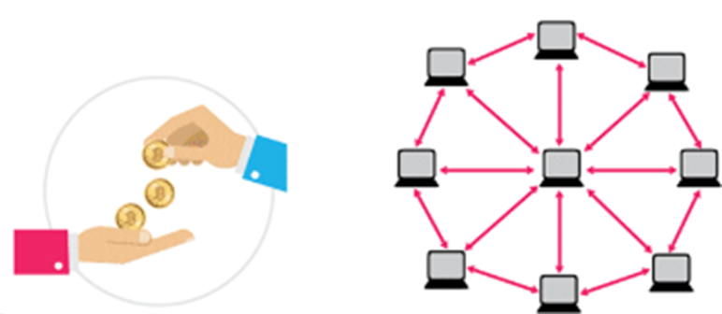
Project analysis slide 2
Blockchain Walkthrough Pt 1
A Blockchain transaction is created and asymmetrically encrypted
The transaction is added to a transaction pool for validation

Slide 6
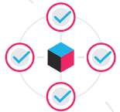
Project analysis slide 2
Blockchain Walkthrough Pt 2
The transaction is verified by the decentralized community of “miners”.
The validated transaction is stored in a block.

Slide 7

Project analysis slide 2
Blockchain Walkthrough Pt 3
The miner creates the proof-of-work that can be used to validate the transaction.
The block and proof-of-work are verified by the community and, if valid, added to the community’s distributed ledger.

Slide 8

Project analysis slide 2
Blockchain Walkthrough Pt 4
The recipient receives the result of the transaction.
The miner that validated the block and generated the proof-of-work receives a reward.

Slide 9
Project analysis slide 2
BLOCKCHAIN APPLICATIONS
Simply Vital Health : A HIPAA compliant heath care solutions provider creating blockchain based applications for patient tracking and electronic health records
GEM: Enterprise Blockchain Application involved with industries across the spectrum from tracking diseases on blockchain for the CDC to, tracking crypto investments, to building an operating system healthcare, GEMOS.
Just in the past week PayPal invested in Cambridge Blockchain to start their shared ledger.

Slide 10
Project analysis slide 2
BigChainDB
For our demo we will show an implementation of a Blockchain Database called BigchainDB.
BigchainDB Features:
Decentralized Control
Transaction Immutability
Standard Queries
Fast Commits
Sybil Tolerance
Notes:
For our demo we will show an implementation of a Blockchain Database called BigchainDB.
BigchainDB Features:
Decentralized Control
Network of peer nodes ensure trust and accountability
Transaction Immutability
Transactions cannot be changed after they are committed to the decentralized network
Standard Queries
MongoDB query engine to access stored transaction and asset data
Fast Commits
Ranges from a few milliseconds to a few seconds to enable use in fast-paced areas, such as stock trading.
Sybil Tolerance
Minimizes false nodes (Sybils) on a network using a governing authority to approve all requests.

Slide 11
Project analysis slide 2
BigChainDB Demo
In this tutorial we cover:
Creating User Identities
Creating Digital Assets
Assigning ownership to assets through a transaction
Transferring assets between two identities
Querying the blockchain for a record of these transactions

Slide 12
BigchainDB Demo

Slide 13
References pt 1
Judd Bagley (2018 , Sep . ). What is Blockchain Technology? A Step-by-Step Guide For Beginners. Blockgeeks. [Online]. Available: https://blockgeeks.com/guides/what-is-blockchain-technology/
http://en.citizendium.org/wiki/Cypherpunk/Citable_Version “Cypherpunk/Citable Version”
David Chaum (1982). Blind Signatures for Untraceable Payments [Online]. Retrieved on Feb 10, 2019 Available: http://www.hit.bme.hu/~buttyan/courses/BMEVIHIM219/2009/Chaum.BlindSigForPayment.1982.PDF
Aaron van Wirdum (April 2018). The Genesis Files: How David Chaum’s eCash Spawned a Cypherpunk Dream [Online]. Retrieved on Feb 10, 2019 Available: https://bitcoinmagazine.com/articles/genesis-files-how-david-chaums-ecash-spawned-cypherpunk-dream/
Hal Finney (August 2004) Reusable Proofs of Work [Online]. Retrieved on Feb 10, 2019 Available: https://web.archive.org/web/20071222072154/http://rpow.net/

Slide 14
References pt 2
https://www.bigchaindb.com/developers/guide/key-concepts-of-bigchaindb/ "Key concepts of BigchainDB“

Slide 15
Thank You

